Slide 1
Measuring Cybercrime: The Example of Online Child Exploitation
Richard Frank (rfrank@sfu.ca)
Assistant Professor
Martin Bouchard (mbouchard@sfu.ca)
Associate Professor
Co-Authors:
Bryan Monk & Russell Allsup

Slide 2
Defining Child Exploitation (CE)
Section 163.1 of the C.C.C:
A photographic, film, video, or other visual representation that shows a person, under the age of 18, engaged in explicit sexual activity OR the dominant characteristic is a sexual organ of a person under the age of 18
Illegal to
Publish (incl. making/printing)
Transmit (incl. distribution, importing, selling)
Knowingly access
Possess
4 exceptions
artistic merit
educational purposes
scientific or medical purposes
‘for the public good’

Slide 3
Goals
Which sites are CE images located on?
Where are those web-sites?
Who do they belong to?
Jurisdiction problems?

Slide 4
Internet
Crawler
Notes:
Describe this in 20 seconds
Mention speeds/capacity

Slide 5
Internet
Keyword Analysis
Hash Database
Crawler
WhoIS
Geodatabase

Slide 6
Used total of 82 keywords
Minimum of seven keywords per page
(Frank, Westlake, & Bouchard, 2010)
Relevant to CE topics
little
boy
reelkiddymov
mafiasex
Bibcamer
naked
paedo
jailbait
lolly
babyshvid
pthc
babyshivid
lover
kiddy
lolli
qqaazz
lola
Bath
nude
…
Keyword Analysis
Hash Database
WhoIS
Geodatabase

Slide 7
Category | Count | Description
1 | 702,997 | Child exploitation. CCC s. 163.1(1)
2 | 2,109,813 | “Gray-area”: An investigator was unable to determine if image depicts a person under the age of 18
3 | 49,419,190 | “Other” material, not child exploitation
Keyword Analysis
Confirmed CE image hashes
Not original images
Provided by RCMP in April 2014
Hash Database
WhoIS
Geodatabase

Slide 8
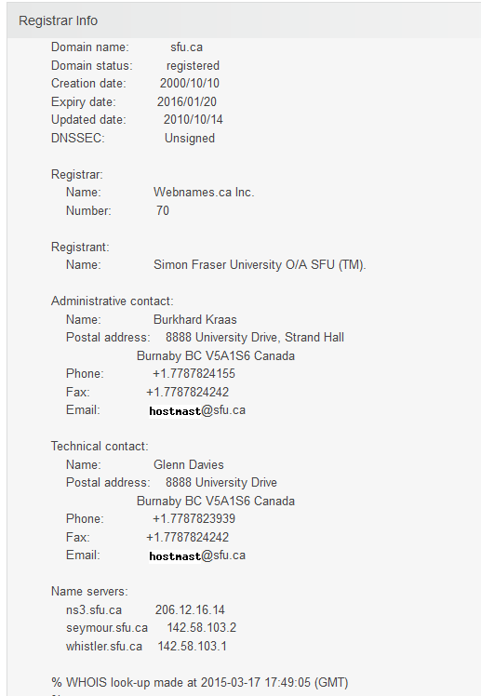
Provides information about the ownership of a domain
Registrant information
Administrative Contact
Technical Contact
Query whoisxmlapi.com
Keyword Analysis
Hash Database
WhoIS
Geodatabase

Slide 9
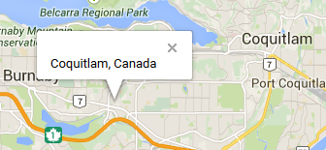
www.sfu.ca
Use MaxMind’s GeoLite DB
Contains ~3m entries
Covers ~3.5b addresses
(total of 4.3b)
Translate to server address(es)
142.58.103.2
GeoDB
Keyword Analysis
X/Y coordinate
Hash Database
WhoIS
Geodatabase
Notes:
SELECT SUM(NumIPs)
FROM (
SELECT intLastIPBase10 - intFirstIPBase10 + 1 as NumIPs
FROM IP_CityBlocks
WHERE intFirstIPBase10 IS NOT NULL
) A

Slide 10
Data Collection
‘draft’ data collection in Nov 2014
1269 pages with confirmed CE
Used as seed pages for ‘final’ data collection
Collected data between Dec 26, 2014 and Jan 10, 2015
Let crawler start from seed sites, and go until no CE content found
Notes:
Crawl 1059
Study focuses on CE/Gray Area

Slide 11
Results
Retrieved 54,156 web-pages & all images on them
Found 4,937 Category 1&2 images
Images spread across
1,166 webpages
63 servers/domains
Encountered 29,272 videos (which we don’t deal with)
Category | Images | Domains
1: CE | 1,569 | 25
2: ‘gray area’ | 3,368 | 47
3: Unrelated | 104,378 | 479
Not in Database | 1,259,496 | 2,402

Slide 12
EXIF
Metadata generated by camera/software
EXIF data was generally blank
1 image was taken with FinePix A345
[others had no such metadata]
10 were saved from Adobe Photoshop CS
1337 were saved from Picasa 3.0
No X/Y coordinates were stored

Slide 13
Domains with CE images
Domain | Cat 1 | Cat 2 | Cat1&2
http://www3.bfcollection.com | 0 | 1,590 | 1,590
http://www.gayteenboylinks.com | 583 | 492 | 1,075
http://www.pichack.com | 438 | 369 | 807
http://www.gayyoungboys.net | 2 | 337 | 339
http://www.gayteenlove.com | 180 | 0 | 180
http://www.gayteenmovies.net | 6 | 148 | 154
http://www.adult-empire.com | 56 | 25 | 81
http://www.twinkssecrets.com | 2 | 51 | 53
http://www.allcuteboys.com | 51 | 0 | 51
http://wetmike.com | 20 | 28 | 48
http://cuteboyblog.com | 36 | 9 | 45
http://thegayteentube.com | 19 | 16 | 35
http://teengaysvideo.com | 19 | 16 | 35
… | … | … | …

Slide 14
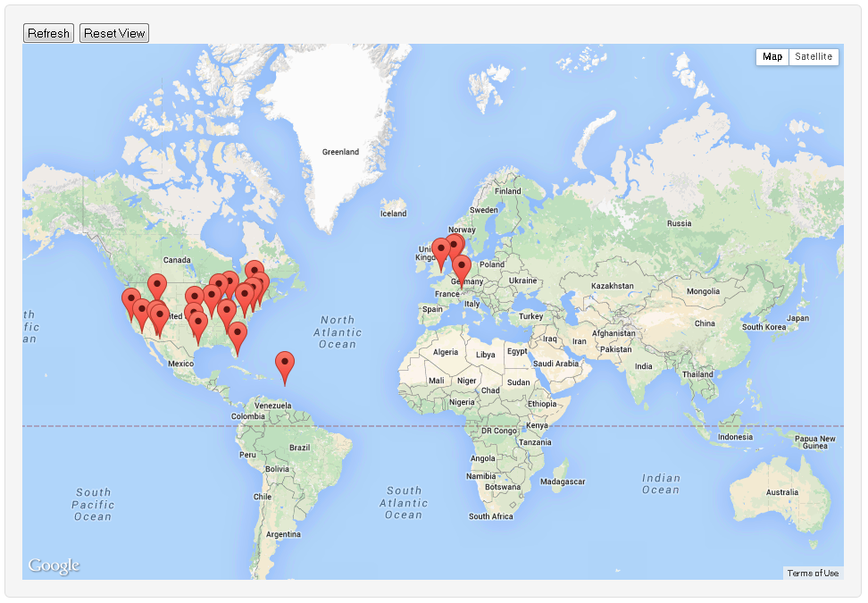
GeoDB
Websites with Category 1 & 2
X/Y coordinate
Translate to server address(es)
Notes:
Where the websites are

Slide 15
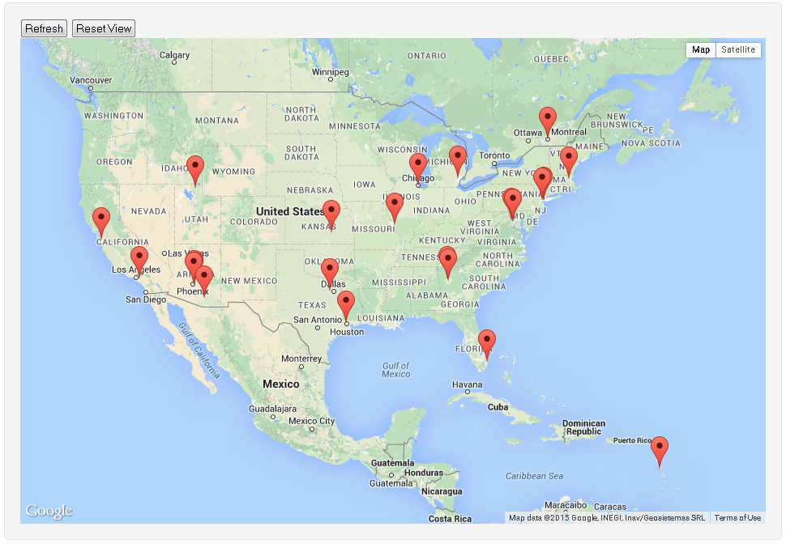
Notes:
Where the websites are

Slide 16
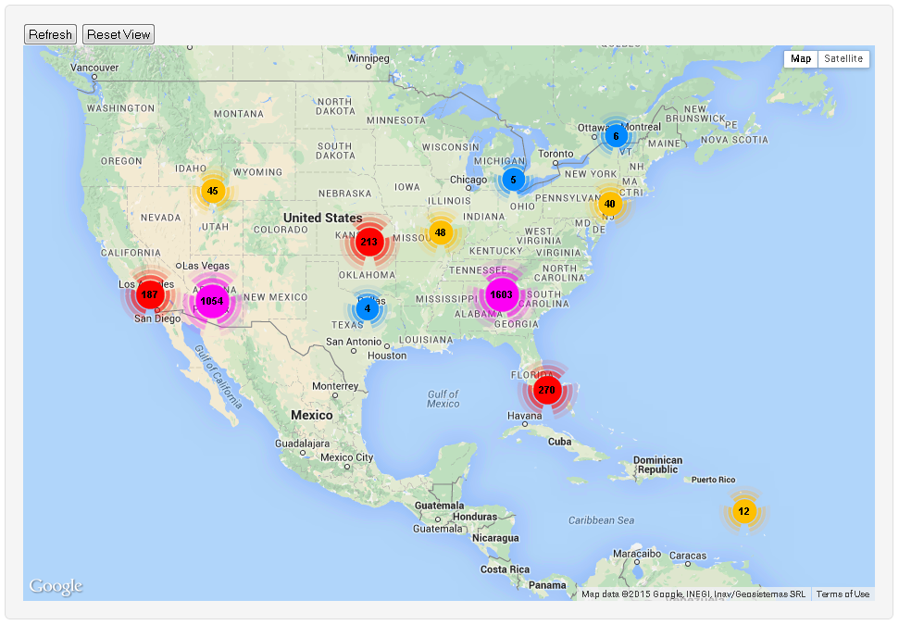
Notes:
Count of images are

Slide 17
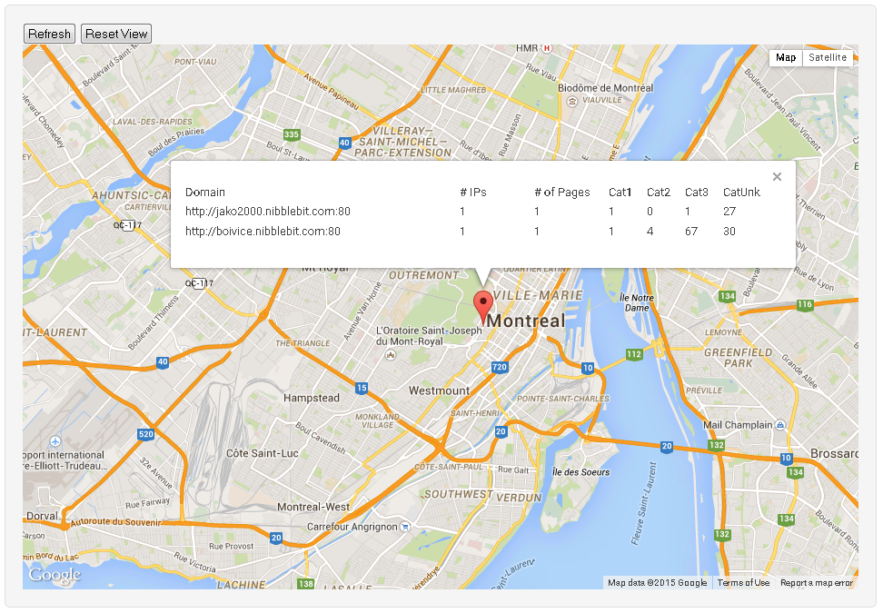

Slide 18
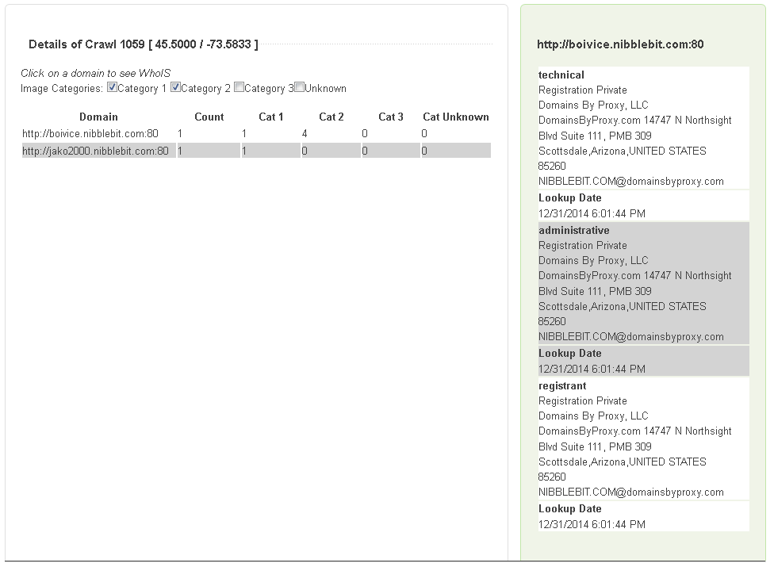

Slide 19
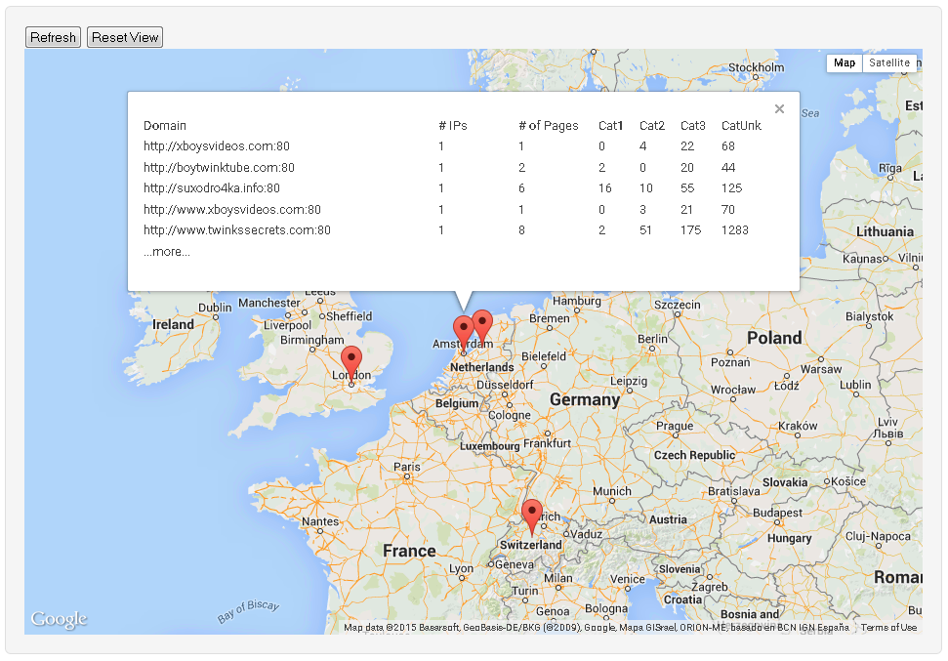

Slide 20
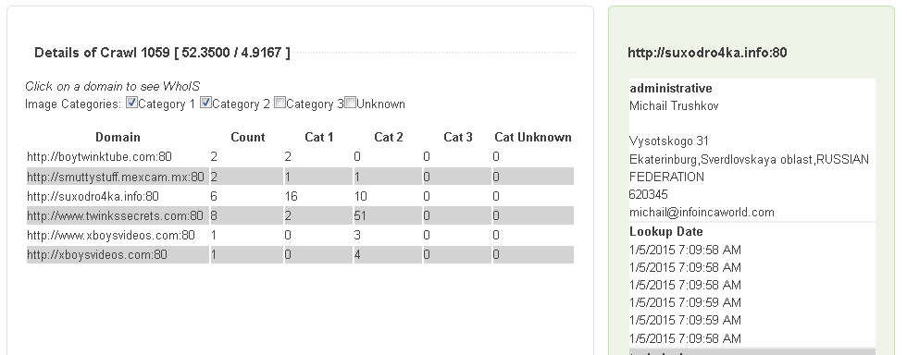
Content accessed from Canada
Website hosted in Netherlands
Domain belongs to Michail in Russia

Slide 21
suxodro4ka.info
Hosted in Netherlands
Person registered from Russia
How to attack this?
Arrest Michail?
He’s in Russia! ☹
Shut server down?
2 problems:
1) It’s easy to replace, rent another and re-upload content
2) Content is not on suxodro4ka.info

Slide 22
Sooo… Where is the content?
suxodro4ka.info references images from
Domain | CE | Gray | Unrelated | ??
http://101boyvideos.com |  |  |  | 5
http://bonerboyblog.com | 2 |  |  | 22
http://boys-cam.com |  |  |  | 2
http://boywankblog.com |  |  |  | 5
http://enigmaticboys.com | 1
http://img.clicksagent.com |  |  | 12
http://promo.adult-empire.com |  |  | 6
http://suxodro4ka.info |  |  |  | 48
http://teenboyswank.com |  |  |  | 13
http://www.abouttwinks.com |  |  |  | 2
http://www.allcuteboys.com | 1 |  |  | 21
http://www.bestgaypass.com |  |  | 1
http://www.gayteenboylinks.com |  |  |  | 2
http://www.gayteenlove.com |  |  | 10 | 29
http://www.pichack.com | 12 | 10 | 44 | 34
Grand Total | 16 | 10 | 73 | 183
Country
Arizona, US
Arizona, US
Arizona, US
Arizona, US
Arizona, US
Russia
Cyprus
Russia
Louisiana, US
Louisiana, US
England
Louisiana, US
Louisiana, US
England
England
Anonymous
Anonymous
Anonymous
Anonymous
Anonymous
Michail
Michail
Anonymous
Anonymous
Anonymous
Anonymous
Content accessed from Canada
Website hosted in Netherlands
Registrant in Russia
Website contains large number of images from site hosted in US, registered in UK

Slide 23
Where are the Servers?
Image → Domain → Server Address → GeoDB → XY
XY coordinate was reverse-geocoded to get address
Servers containing CE material
Country Name | Cat 1 |  |  | Cat 2 |  |  | Cat 1&2
?? | 1 |  | (2.38%) | 1 |  | (2.27%) | 1 |  | (1.59%)
United Kingdom | 2 |  | (4.76%) | 3 |  | (6.82%) | 4 |  | (6.35%)
United States | 30 |  | (71.43%) | 31 |  | (70.45%) | 47 |  | (74.60%)
Canada | 1 |  | (2.38%) | 1 |  | (2.27%) | 1 |  | (1.59%)
Dominica | 1 |  | (2.38%) | 1 |  | (2.27%) | 1 |  | (1.59%)
Netherlands | 7 |  | (16.67%) | 7 |  | (15.91%) | 9 |  | (14.29%)
 | 42 |  |  | 44 |  |  | 63
Notes:
# of IPs in each country
[webpages hosted from multiple servers are counted multiple times]
There’s overlap between Cat 1 and Cat 2, hence why Cat 1 + Cat 2 =/= Cat 1&2

Slide 24
Where are the …?
Webpages
Images
Country Name | Cat 1 |  |  | Cat 2 |  |  | Cat 1&2
?? | 2 |  | (0.30%) | 6 |  | (0.83%) | 8 |  | (0.69%)
United Kingdom | 3 |  | (0.45%) | 35 |  | (4.84%) | 36 |  | (3.09%)
United States | 551 |  | (82.36%) | 562 |  | (77.73%) | 991 |  | (84.99%)
Canada | 2 |  | (0.30%) | 1 |  | (0.14%) | 2 |  | (0.17%)
Dominica | 1 |  | (0.15%) | 5 |  | (0.69%) | 6 |  | (0.51%)
Netherlands | 110 |  | (16.44%) | 114 |  | (15.77%) | 123 |  | (10.55%)
 | 669 |  |  | 723 |  |  | 1166
Country Name | Cat 1 |  |  | Cat 2 |  |  | Cat 1&2
United Kingdom | 0 |  | (0.00%) | 311 |  | (9.18%) | 311 |  | (6.15%)
United States | 1654 |  | (98.86%) | 3,009 |  | (88.81%) | 4,663 |  | (92.14%)
Canada | 3 |  | (0.18%) | 4 |  | (0.12%) | 7 |  | (0.14%)
Dominica | 1 |  | (0.06%) | 11 |  | (0.32%) | 12 |  | (0.24%)
Netherlands | 15 |  | (0.90%) | 53 |  | (1.56%) | 68 |  | (1.34%)
 | 1,673 |  |  | 3,388 |  |  | 5,061
Notes:
# of IPs in each country

Slide 25
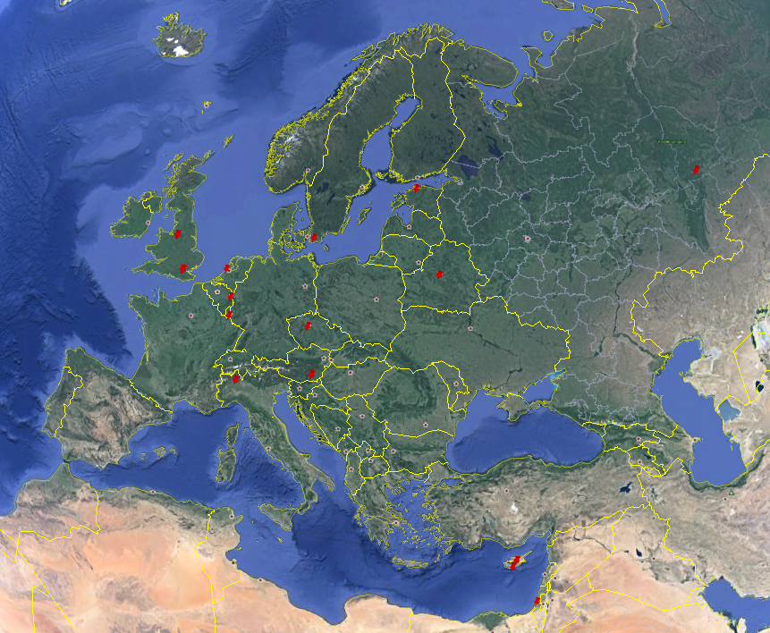
Distribution of Contact Info
Country | Anon | Name Given
Argentina |  | 12
Australia | 6
Austria |  | 9
Bahamas |  | 3
Belarus |  | 6
Cyprus |  | 10
Czech Republic |  | 3
Estonia |  | 3
Israel |  | 2
Italy |  | 3
Luxembourg | 3
Mexico |  | 4
Netherlands |  | 5
Panama | 21
Russian Federation |  | 4
Sweden |  | 3
United Kingdom | 52 | 15
United States | 62 | 12
Grand Total | 144 | 94
Notes:
SELECT *
FROM CrawlSummary_V03.dbo.WhoIS_Contacts WIC, (
--get the unique domain names in this crawl with CE pages
SELECT txtDomainName, MAX(intWhoIsID) as intWhoIsID
FROM (
SELECT W.*
FROM CrawlDB_V03_1059.dbo.URLsVisited U, CrawlSummary_V03.dbo.WhoIS W
WHERE U.intWhoIsID = W.intWhoISID AND U.intURLID IN (
SELECT intURLID
FROM ImageLog
WHERE intCategory IN (1, 2)
)
) A
GROUP BY txtDomainName
) LatestWhoIS
WHERE LatestWhoIS.intWhoISID = WIC.intWhoISID

Slide 26
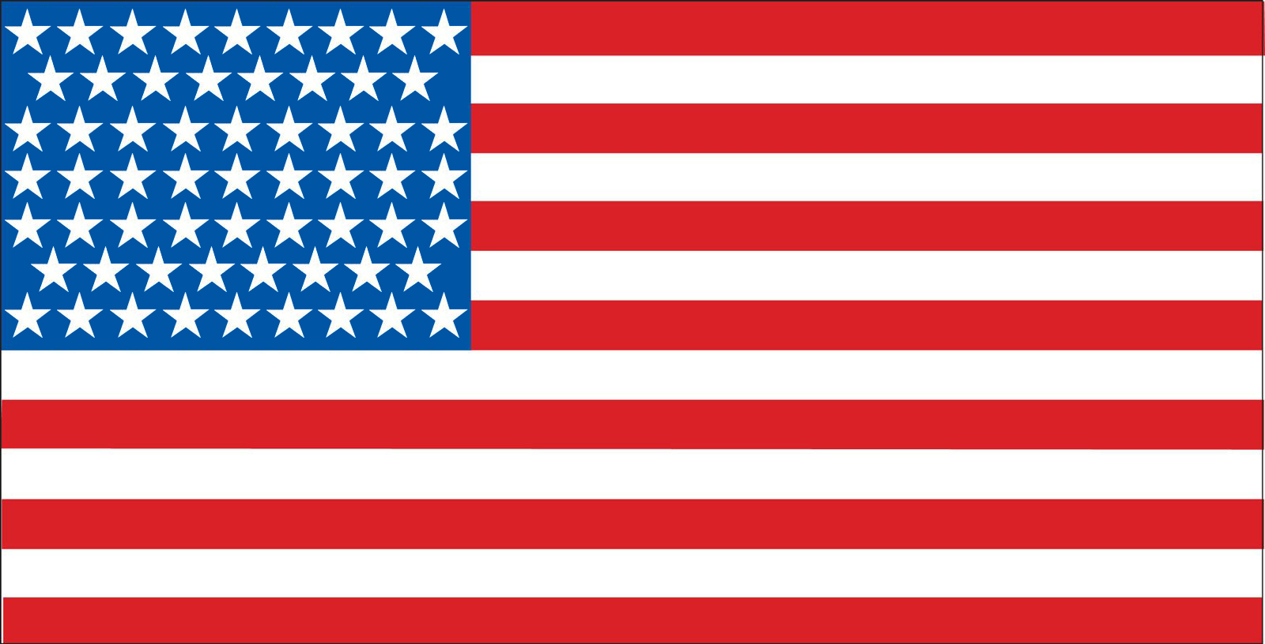
Summary
US has
~75% of the servers
~85% of the webpages
~99% of the Category 1, 89% of Category 2 images
Largest section (~26%) of anonymous registrants
Even though
Regardless of state, it is a Federal crime
US has stronger CE laws than Canada
Cannot access for academic purposes either
(See 18 U.S.C. § 2251; 18 U.S.C. § 2252; 18 U.S.C. § 2252A)
Large statutory minimum sentences
Ex: 5 years for transporting
Why?

Slide 27
Summary
2nd most prominent location for webpages/servers
Netherlands has
16% of servers with Category 1 images
16% of webpages analyzed with Category 1
<1% of Category 1 images
Even though
Laws very similar to US
(punishment is not as severe)
Why?

Slide 28
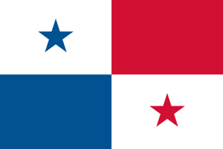
Summary
UK had
2nd largest in anonymous registrations
2 servers hosting webpages referencing Category 1 images
Hosted no Category 1 images
Laws very similar to Netherlands, US and Canada
Very large number of CE-related prosecutions
Panama had
No servers, no images
8 (of 63) websites were registered through Panama anonymously
Laws similar to Netherlands, US and Canada

Slide 29
Conclusions
This was only one data collection effort
Revealed complex picture of CE on websites
Websites typically hosted in countries that
Are well-connected, with good infrastructure
Have strong CE laws
Although websites contain CE images, they are hosted elsewhere
Large amount of registrants were anonymous
Future?

Slide 30
Measuring Cybercrime: The Example of Online Child Exploitation
Richard Frank (rfrank@sfu.ca)
Assistant Professor
Martin Bouchard (mbouchard@sfu.ca)
Associate Professor
Co-Authors:
Bryan Monk & Russell Allsup

